Slide 1
Unit Testing and Rhino.Mocks
Ivan Krivyakov
Senior Managing Consultant
SunGard Consulting Services
E-mail:
Ivan.Krivyakov@SunGard.com
ivan@ikriv.com
http://www.ikriv.com/demo/RhinoMocks/

Slide 2
Unit Testing and Rhino.Mocks
Unit Testing and Rhino.Mocks
What makes test a unit test
Tools of the trade:
Unit testing frameworks
Continuous integration
Dependency injection
Mock libraries
Writing tests with Rhino.Mocks:
Almost real code example
Roadmap to good tests
References

Slide 3
Unit Testing and Rhino.Mocks
Unit Tests vs. Other Kinds of Tests
Performed on the class (“unit”) level
Each unit is tested in isolation
Automatic
Create class object, call methods, check results

Slide 4
Unit Testing and Rhino.Mocks
Unit Testing
In Isolation
Automatic
Replace Dependencies…
…with Mocks
Unit Testing Framework
Continuous Integration
Dependency Injection Framework
Mock Library
nUnit
mbUnit
xUnit.Net
VS TestTools
CrouiseControl.Net VS Team System
nMock EasyMock Rhino.Mocks TypeMock
By hand
Spring.Net Castle/Windsor Unity StructureMap

Slide 5
Unit Testing and Rhino.Mocks
Class Under Test May Call Many Others
In a unit test we want to test just one class, not the whole calling graph
ClassUnderTest
Dependency1
Dependency2
Dependency3
ClassA
ClassB
ClassC
ClassD
ClassE
F
G
H
I
J
K
L
M
N
Database
Network
File System
Printer
Nuclear Rocket Launcher

Slide 6
Unit Testing and Rhino.Mocks
Replace Dependencies with Mocks
This reduces amount of code under test to just one class
ClassUnderTest
Dependency1
Mock
Dependency2
Mock
Dependency3
Mock

Slide 7
Unit Testing and Rhino.Mocks
A Word about Integration Tests
Tests that involve many classes are integration tests
In other words: test reading from a database is not a unit test
Integration tests verify the wiring between classes
Unit tests verify classes in isolation
We need both: neither is a replacement of the other

Slide 8
Unit Testing and Rhino.Mocks
Unit Testing Frameworks
nUnit (www.nunit.org)
mbUnit (www.mbunit.com)
xUnit.Net (http://www.codeplex.com/xunit)
Visual Studio Test Tools
[TestClass]
public CalculatorTest
{
[TestMethod]
public void TestSomething()
{
Assert.AreEqual(4,
new Calculator().Multiply(2,2));
}
}

Slide 9
Unit Testing and Rhino.Mocks
What Unit Tests are For
We want proof that our classes work right
If we had a bug, we want proof it won’t happen again
If we change the code, we want proof we did not break anything
If we do break something, we want to know about it as quickly as possible
If we do break something, we want to know what exactly is broken: a failing test is the ultimate form of bug report

Slide 10
Unit Testing and Rhino.Mocks
Test Driven Development Rules
Adding New Functionality “Test First”
Write an “empty” implementation
Write a failing test: this is your requirements
Make the test pass
We are now sure that the requirements are satisfied
Fixing a Bug
Write a failing test that demonstrates the bug
Fix the bug
The test will make sure the bug does not happen again
Changing Implementation
Make your changes
Make sure all tests pass
We now are confident all requirements are still satisfied

Slide 11
Unit Testing and Rhino.Mocks
Continuous Integration
We want to run tests as often as possible
Ideally after every compilation
At least on every check-in
“Daily builds are for wimps” (Michael Two)
Tests should be fast: we are going to have hundreds of them
1 second test is too long
Complete automation: absolutely no human interaction allowed
Visual Studio Team System, CruiseControl.NET

Slide 12
Unit Testing and Rhino.Mocks
Beware: Hard Coded Dependencies Bite
double GetPrice(int productId)
{
using (SqlConnection conn = new SqlConnection(
Config.ProductsDbConnectionString))
{
conn.Open();
double price = ReadPriceFromDb(conn, productId);
if (DateTime.Now.DayOfWeek==DayOfWeek.Wednesday)
{
// apply Wednesday discount
price *= 0.95;
}
return price;
}
}

Slide 13
Unit Testing and Rhino.Mocks
Replaceable Dependencies
All dependencies are explicitly passed in constructor/method parameters or properties
If it is not passed, it should not be used
Must avoid hidden dependencies
Static methods (like DateTime.Now)
Singletons
“new”
The only place where things are “new’ed” is a factory class or a factory method, which is not unit tested

Slide 14
Unit Testing and Rhino.Mocks
Dependency Injection Frameworks
http://www.martinfowler.com/articles/injection.html
Spring.Net – a sister of Java’s Spring http://www.springframework.net/
Castle/Windsor http://www.castleproject.org/
Unity – Microsoft http://www.codeplex.com/unity
StructureMap – Jeffrey Miller http://structuremap.sourceforge.net/

Slide 15
Unit Testing and Rhino.Mocks
Mocking Dependencies
Mocks are more than just stubs http://martinfowler.com/articles/mocksArentStubs.html
Stubs supply data, mocks verify calls
Mocks are difficult to write by hand
Not all dependencies can be mocked
Mock libraries:
nMock (www.nmock.org)
EasyMock (easymock.org)
TypeMock (www.typemock.com)
Rhino.Mocks (ayende.com/projects/rhino-mocks.aspx)

Slide 16
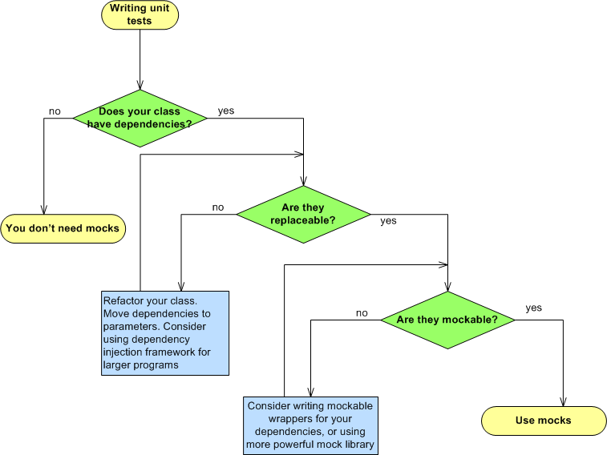
Unit Testing and Rhino.Mocks

Slide 17
Unit Testing and Rhino.Mocks
Why Rhino.Mocks?
Open Source
Type safe syntax: no method names as strings
Flexible mocking options
Compact arrange-act-assert syntax
Can mock more classes than some other libraries

Slide 18
Unit Testing and Rhino.Mocks
Testing with Rhino.Mocks
Arrange
Create mock/stub for each dependency: MockRepository.GenerateMock<MyType>(); MockRepository.GenerateStub<MyType>();
Setup stubs: db.Stub(x=>x.GetCount(“f”)).Return(42);
db.Stub(x=>x.GetNameFromAddress(null)) .IgnoreArguments().Return(“John Doe”);

Slide 19
Unit Testing and Rhino.Mocks
Testing with Rhino.Mocks
Act
Create test object: MyClass CreateObject() { return new MyClass(_mock1, _mock2, _mock3); }
Call method(s) and get results: decimal profit = CreateObject().CalculateProfit(2009);

Slide 20
Unit Testing and Rhino.Mocks
Testing with Rhino.Mocks
Assert
Assert.AreEqual(42, profit);
file.AssertWasCalled(x=>x.Save(“foo”)); file.AssertWasNotCalled(x=>x.Delete(“foo”));
account.AssertWasCalled( x=>x.Update(Arg<string>.Is.Anything,
Arg<decimal>.Is.Equal(42.0));

Slide 21
Unit Testing and Rhino.Mocks
Writing Good Tests with Mocks
Arrange-act-assert
Test one thing at a time
One method – many tests
Do not repeat the method logic
Keep it simple

Slide 22
Unit Testing and Rhino.Mocks
Almost Real Life Sample
Image Resizer

Slide 23
Unit Testing and Rhino.Mocks
Production
ImageResizer
ScaleCalculator
ResizeController
ImageIO
ImageFolders
Test
ImageResizer Mock
ScaleCalculator Mock
ResizeController
ImageIO
Mock
ImageFolders Mock

Slide 24
Unit Testing and Rhino.Mocks
Calling Options
Repeat s.Stub(x=>x.Fun(1)).Return(10).Repeat.Once(); s.Stub(x=>x.Fun(1)).Return(20).Repeat.Twice(); s.Stub(x=>x.Fun(1)).Return(30).Repeat.Times(5); s.Stub(x=>x.Fun(1)).Return(40).Repeat.Any(); m.AssertWasCalled(x=>x.Fun(1), call=>call.Repeat.Once());
Ignore Arguments s.Stub(x=>x.Fun(0)).IgnoreArguments().Return(10); m.AssertWasCalled(x=>x.Fun(0), call=>call.IgnoreArguments());

Slide 25
Unit Testing and Rhino.Mocks
Calling Options (Continued)
Constraints Return 42 when second argument is >5 s.Stub(x=>x.Fun( Arg<string>.Is.Anything, Arg<int>.Is.GreaterThen(5))) .Return(42); Assert a call to m.Fun(“wow”, any number); m.AssertWasCalled(x=>x.Fun( Arg<string>.Is.Equal(“wow”), Arg<int>.Is.Anything));

Slide 26
Unit Testing and Rhino.Mocks
Calling Options (Continued)
Do Perform arbitrary action upon call. s.Stub(x=>x.Fun(null,0)) .IgnoreArguments() .Do(new Func<string,int,string>( delegate(string s, int n) { return String.Format(“{0}.{1}”, s, n); }));

Slide 27
Unit Testing and Rhino.Mocks
Stub Rules
Stubs work like filters: first match is applied
Put specific stubs before general stubs s.Stub(x=>x.Fun("foo“,3)).Return(42); s.Stub(x=>x.Fun(null,0)) .IgnoreArguments().Return(10);
Stubs are not for verification. Make them as general as possible.
Most often stubs ignore arguments.

Slide 28
Unit Testing and Rhino.Mocks
Stubs vs. Mocks
Stub for the most general case
Assert with the most specific arguments
Stub is typically used in all tests, call asserted in one test public void MyMethod_Calls_Fun() { _mock.Stub(x=>x.Fun(null,0)) .IgnoreArguments().Return(42); CreateObject().MyMethod(10); _mock.AssertWasCalled(x=>x.Fun(“boo”, 10)); }

Slide 29
Unit Testing and Rhino.Mocks
DRY – Don’t Repeat Yourself
Don’t duplicate full method logic in test
Some duplication is inevitable, but…
Ideally you should have one assert per test
Stubs often repeat themselves. Isolate the common set of stubs in a method

Slide 30
Unit Testing and Rhino.Mocks
Lambda Expressions Primer
x => x.GetData(“foo”) function returning x.ToUpper(), type of x is implied from context: string func(IDataProvider x) { return x.GetData(“foo”); }
()=>42 function taking no arguments, i.e. int func() { return 42; }

Slide 31
Unit Testing and Rhino.Mocks
Mockable Classes
Dynamic assembly generated by Rhino.Mocks must be able to see the class
For | Rhino.Mocks can mock | How
Interfaces | All methods | Create implementation
Delegates | Any delegate | Create implementation
Classes derived from MarshalByRefObject | All methods | Some remoting magic
Other non-sealed classes | Virtual methods | Create derived class
Other sealed classes | Nothing | N/A

Slide 32
Unit Testing and Rhino.Mocks
Roadmap to Testable Code
Dependency Injection with a framework or “by hand”
Mocks
Single Responsibility Principle
Production code: do one thing at a time
Test code: test one thing at a time

Slide 33
Unit Testing and Rhino.Mocks
Rhino Mocks Versions
Rhino.Mocks is a dynamic project…
Versions prior to 3.5 used record-replay paradigm
Many older documents refer to record-replay and make no mention of AAA
Starting from version 3.6 Rhino.Mocks requires .NET framework 3.5

Slide 34
Unit Testing and Rhino.Mocks
Don’t Lambdas Require .NET 3.0?
Yes, they do. In fact, Rhino.Mocks v3.6 requires .NET 3.5
What if my production environment has only .NET 2.0?
You can put your tests in a separate project. Just test project(s) will require .NET 3.5
Your main project(s) can stay on .NET 2.0, and only those projects will be deployed to production

Slide 35
Unit Testing and Rhino.Mocks
Rhino Mocks Resources
Author: Oren Eini a.k.a. Ayende Rahien http://www.ayende.com/
Rhino.Mocks Downloads http://ayende.com/projects/rhino-mocks/downloads.aspx
Rhino.Mocks 4.0 Features Forum http://nhprof.uservoice.com/pages/28152-rhino-mocks-4-0
Rhino.Mocks Discussion Forum (bugs, etc.) http://groups.google.com/group/rhinomocks
AAA explained (v3.5 Release Notes) http://www.ayende.com/Wiki/Rhino+Mocks+3.5.ashx

Slide 36
Unit Testing and Rhino.Mocks
Refererences:
Michael C. Feathers. Working Effectively with Legacy Code.
Ron Jeffries. Extreme Programming Adventures in C#
Kent Beck. Extreme Programming Explained: Embrace Change

